Slide 1
GAAAN
Generative Album Art Adversarial Network
By Patrick Caldwell, Josh Matthews, and Michael McDermott

Slide 2
GAN Album Generator
•Project Summary
•The purpose of GAAAN was to offer a tool for musicians and artists to have unique album artwork generated quickly at no cost. The tool is a website with a backend running on flask and a Deep Convolutional Generative Adversarial Network using tensorflow-keras. To train the GAAAN, we curated our own dataset using the Spotify API and some custom functions to grab about 54,000 images for training.

Slide 3
Team
Patrick Caldwell
-Configuration of Flask server and deployment to Google App Engine and GCP
Joshua Matthews
-Training GAN and tuning hyperparameters
Michael McDermott
-Data sourcing & cleaning, GAN modeling and training

Slide 4
Our Deliverables
•Code Repo (URL):https://github.com/mmcdermott011/GAAAN/tree/master
•Presentation Slides (URL):https://github.com/mmcdermott011/GAAAN/tree/master/Deliverables
•Demo Screen Capture Images (URL):https://github.com/mmcdermott011/GAAAN/tree/master/Deliverables

Slide 5
Project Summary
•Code What it is and what results you’ve got

Slide 6
Machine Learning Aspects
•Data

Slide 7
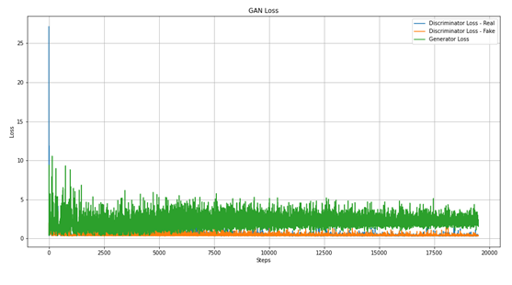
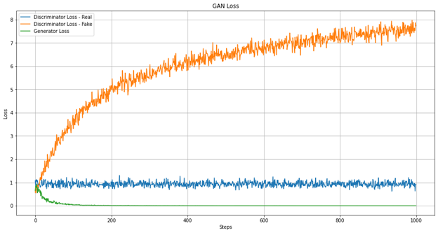
Machine Learning Aspects
•Model
The model was mainly measured on loss and our own interpretation of whether we thought the output could pass as an album art image or not. The accuracy and loss metrics were mainly helpful if the generator or discriminator rapidly approached zero or mode collapsed. From our research, we have seen that the loss can fluctuate and even if the generator or discriminator have a loss between .5 – 5 the output could still be good or bad. Metrics really just helped us keep an eye on the training to alert us if there were any drastic changes made. Otherwise, every 50 or so epochs we would have the output printed to screen to see what it looked like and judged our model based off of that.
Graph of first version loss
Loss Graph after architecture revision

Slide 8
Machine Learning Aspects
•Model
Our model is a deep convolutional generative adversarial network. We chose this architecture due to it being more stable than other GAN’s. We considered using StyleGAN, but the custom libraries and setup would have taken more time which would have given us less time to experiment. The architecture consists of a generator model and discriminator model. Both have convolutional layers and batch normalization layers. The discriminator model is trained on both the dataset of sourced images, and the output of the generator. Each epoch, the discriminator is updated on whether it was good at detecting a real vs generated image, and the generator is updated on whether it was able to trick the discriminator or not.

Slide 9
Machine Learning Aspects
•Training
o We experimented with multiple epoch lengths and sizes of training data.
o Epoch lengths of 5,000, 10,000, 50,000, 75,000, and 100,000 were used.
o Training data sizes consisted of 54,000 images for a version that was trained on the whole dataset, 8,000 images for the subset of electronic and psychedelic images, and about 5,000 images for the metal/alt rock subset.
o The main hyperparameters that we tuned were the learning rate for the discriminator and generator, number of epochs, noise vector size, strides and kernel size in the convolutional layers, and momentum in batch normalization layers. The current versions have a learning rate of .0015 for the discriminator and learning rate of .0015 for the generator. The batch normalization momentum is currently 0.8.

Slide 10
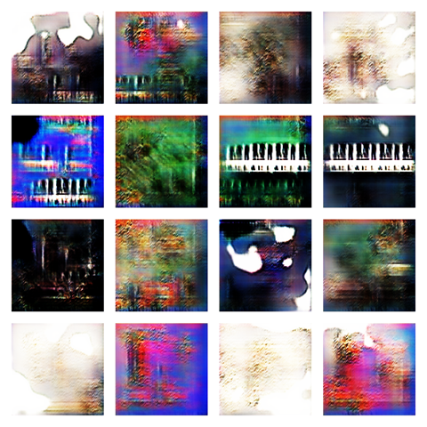
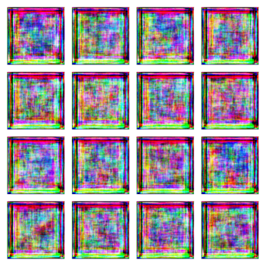
Machine Learning Aspects
•Training
Output of first version trained on full dataset Output of second version trained on full dataset at 12,000 epochs

Slide 11
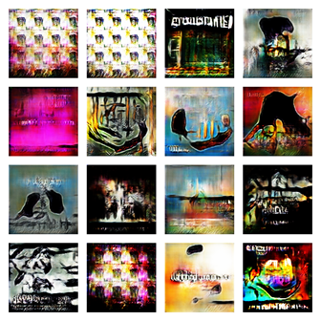
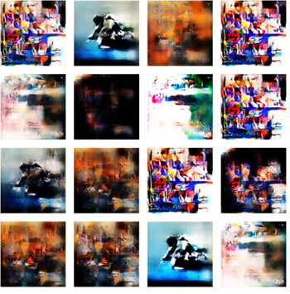
Machine Learning Aspects
•Training
Output of final version of electronic and psychedelic genres
Output of final version of rock genre GAN trained only on rock/metal genres (34,000 epochs)

Slide 12
Machine Learning Aspects
•Training
EDM training: https://imgur.com/XGrmRR1
Metal training: https://imgur.com/ZyyivO7

Slide 13
Machine Learning Aspects
•Inference
• Our model's “prediction” is the output of an image, given a random noise vector that is generated by the server when it is called.

Slide 14
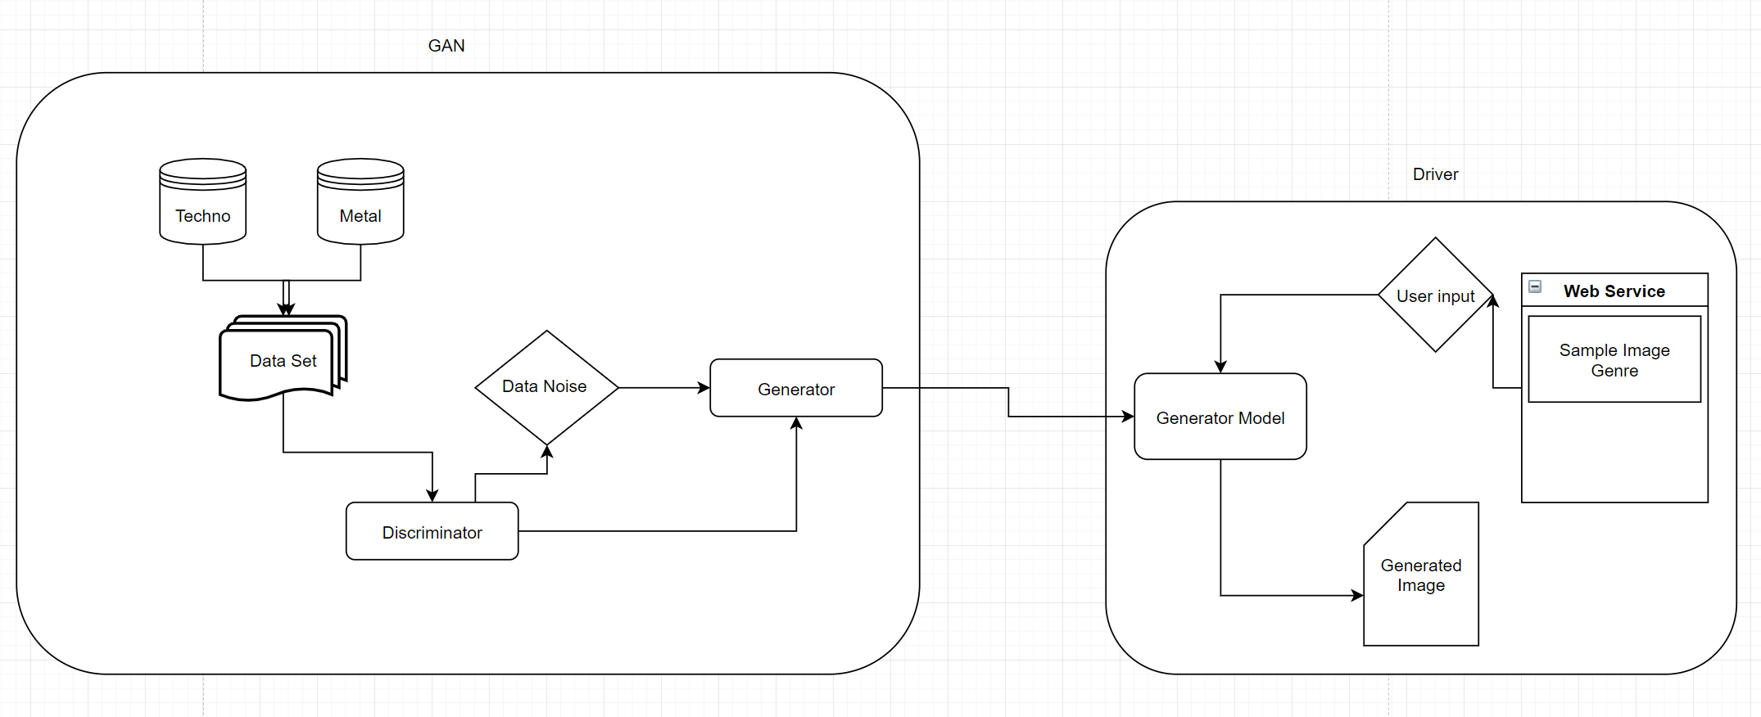
Software
•Architecture
• The project is delivered as a web service with an already trained model
• We took multiple data sets and trained images using different noise figures in order to get a result that was usable on the web service.

Slide 15
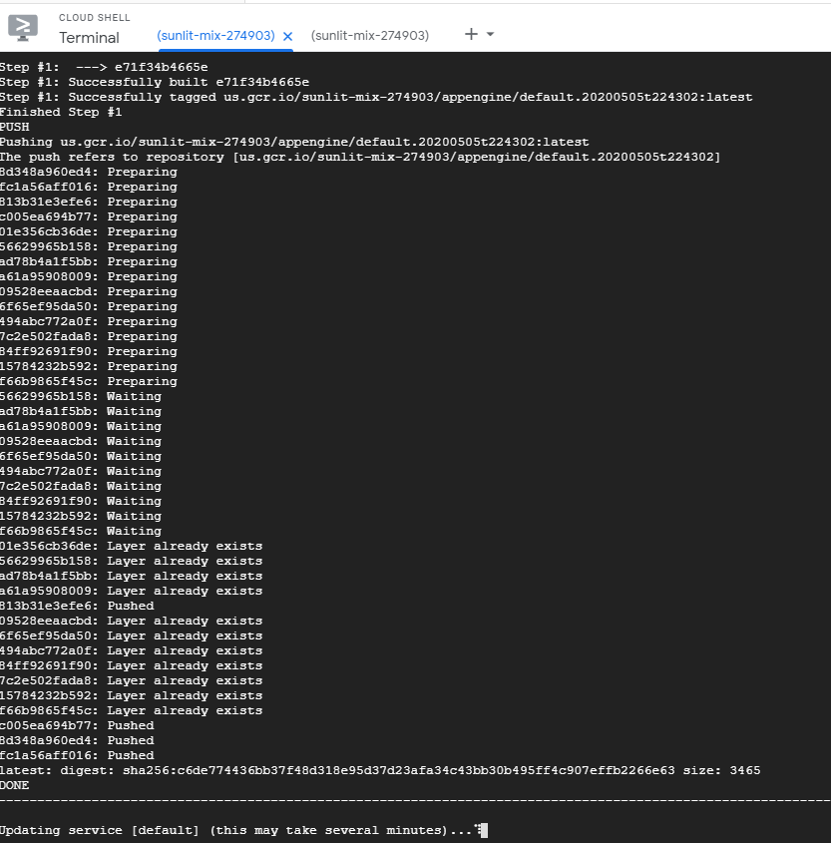
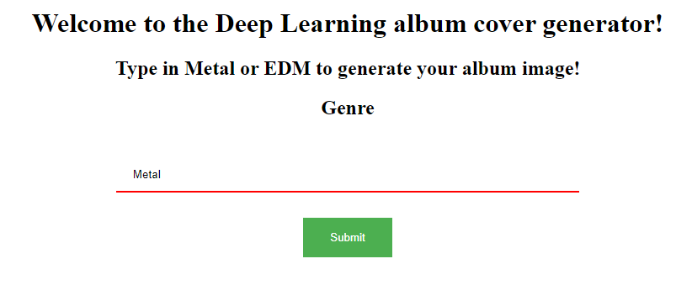
Software
•User interface
Is a static html page with a flask wrapper which uses GET and POST functionality in order to utilize the driver code.
https://sunlit-mix-274903.wl.r.appspot.com/

Slide 16
Tests/Demo
•Screen Capture Images

Slide 17
Tests/Demo
•Use Cases

